Slide 1
Business Use Cases
Lecturer: Ngo Huy Bien
Software Engineering Department
Faculty of Information Technology
VNUHCM - University of Science
Ho Chi Minh City, Vietnam
nhbien@fit.hcmus.edu.vn

Slide 2

Objectives
To analyze application software business requirements.
To document application software business requirements.

Slide 3

Contents
Context Diagram
Scenarios (Workflows)
Storyboards
Screenshots
Quick and Dirty Prototype
Process Flow
Activity Diagram
The Brown Cow Model

Slide 4

References
Suzanne Robertson and James Robertson (2012). Mastering the Requirements Process. Addison Wesley Professional.
Joy Beatty and Anthony Chen (2012). Visual Models For Software Requirements. Microsoft Press.

Slide 5

Problem Analysis and Specification
The purpose of software is to solve problems.
How do we analyze and document problems?
Solution
Analysis
Problem

Slide 6
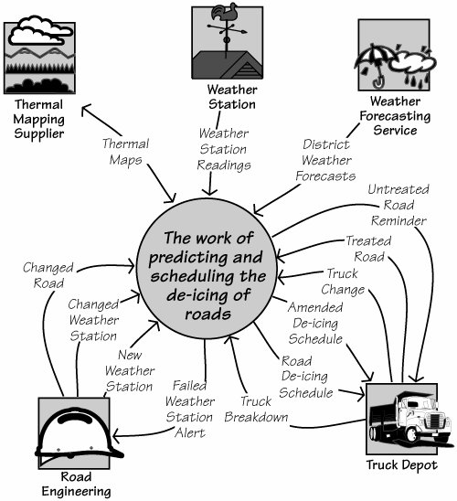
Context Diagram [1]

Slide 7
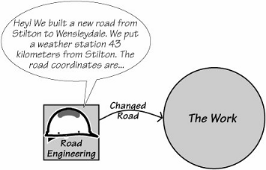
Business Events
Any system or piece of work responds to things that happen outside it. We call these happenings business events.
A business event takes place outside the scope of the work.
The work learns that it has happened through the arrival of an incoming flow of information.
Business events are determined using the flows from the adjacent systems on the context diagram.

Slide 8
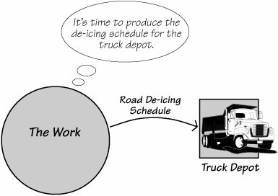
Time-Triggered Business Events
A time-triggered business event happens when a prearranged time is reached.
This is based on either
a periodic occurrence (for example, the end of the month, or 5 P.M. each day),
a fixed time interval (three hours since the last occurrence), or
a certain amount of time elapsing since another business event (30 days after sending out an invoice).

Slide 9


Finding Business Events
You need some knowledge of the work to figure out the business events.
Identify key roles (aka user types) from key stakeholders.
Identify business events caused by a key role’s action.

Slide 10



Example
Calling a cab.
Waiving vs. calling vs. touching.

Slide 11
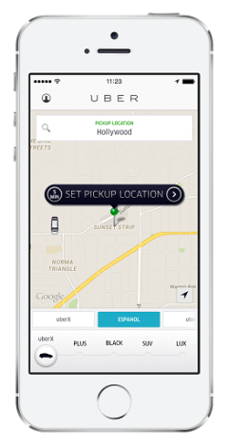
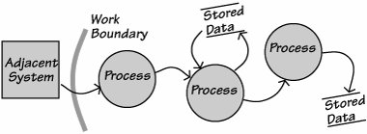
Business Use Cases
When a business event happens, the work responds by initiating a business use case.
The business use cases are the work's responses to the business events.
The work's response to the business event is to continue processing until all active tasks (the processes) have been completed and all data retrieved or stored.
The business use case is a collection of identifiable processes, data that is retrieved and/or stored, output generated, messages sent, or some combination of these.

Slide 12
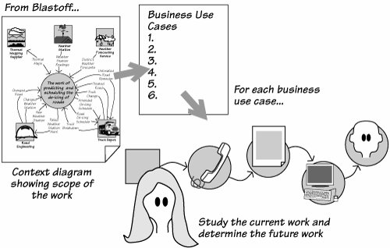
Determine Business Use Cases
From the work context diagram, you determine the business events and the resulting business use cases.
The business use cases are studied until the analyst understands the desired functionality of the work and the part of that functionality to be performed by the product.

Slide 13
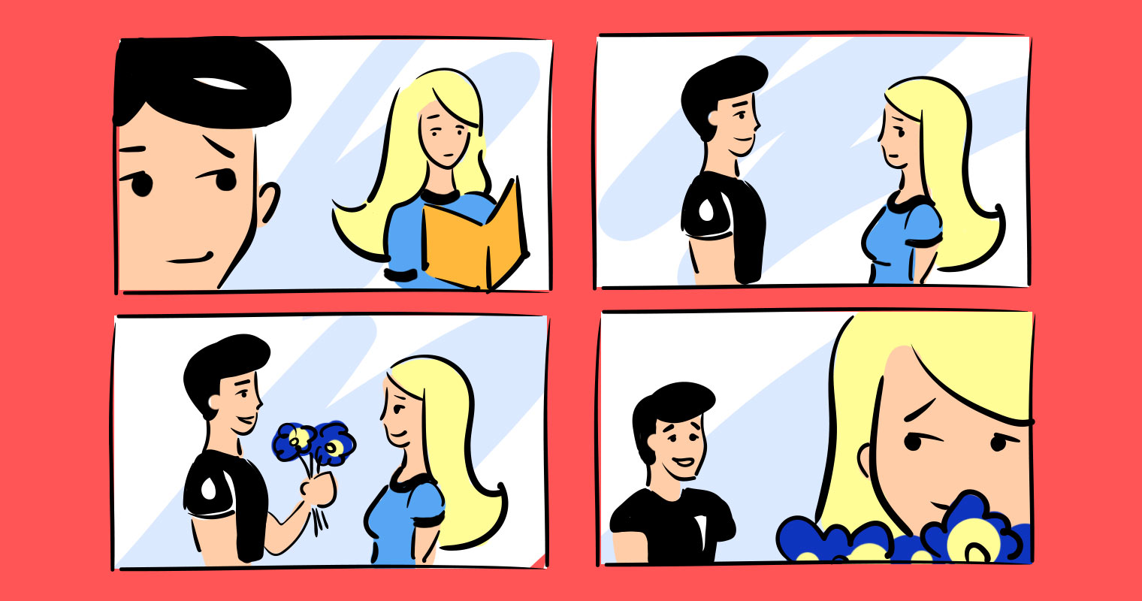
Scenario (Workflow)
The scenario tells the story of a business use case.

Slide 14
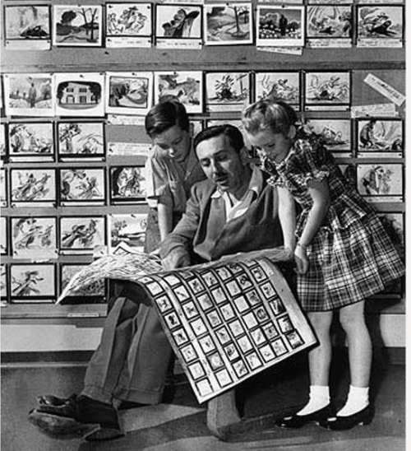
Documenting Scenario: Storyboards
Storyboards are a prototyping technique borrowed from the film and cartoon industries.
When a cartoonist is planning a cartoon, he sketches a number of linked pictures.
These pictures identify the story line and guide the cartoonist in how many detailed pictures he needs to draw.

Slide 15
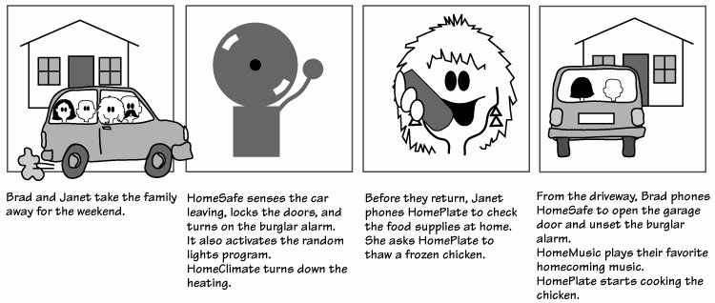
Building a Storyboard
Building a storyboard means thinking of the proposed functionality as a story and breaking it into a series of steps, or discrete actions.
Draw each action as a panel of the story.

Slide 16
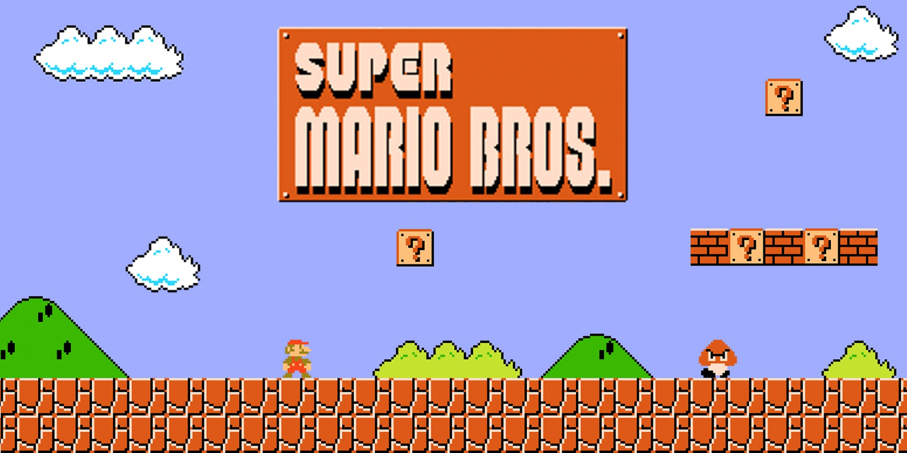


Documenting Scenario: Pictures

Slide 17
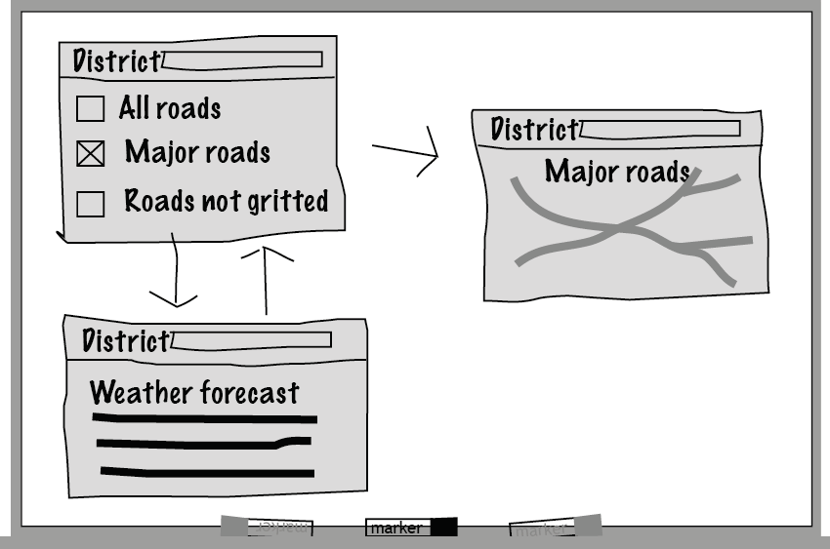
Documenting Scenario: Quick and Dirty Prototype
https://balsamiq.com/

Slide 18
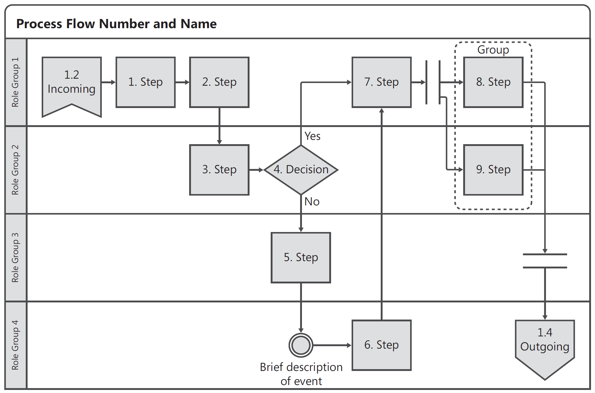
Documenting Scenario: Process Flow [2]
https://www.lucidchart.com

Slide 19
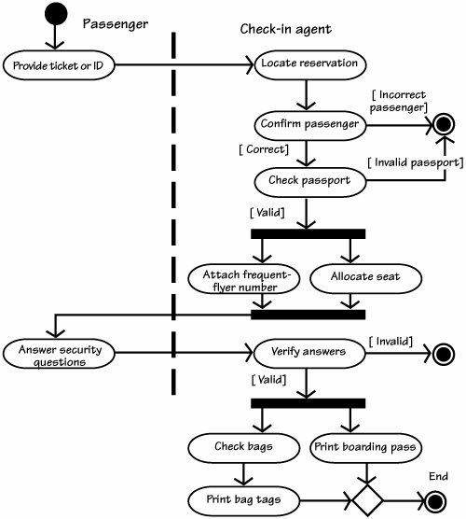

Documenting Scenario: Activity Diagram
See Software Requirements: 05.1. The Unified Modeling Language.pptx for details.

Slide 20
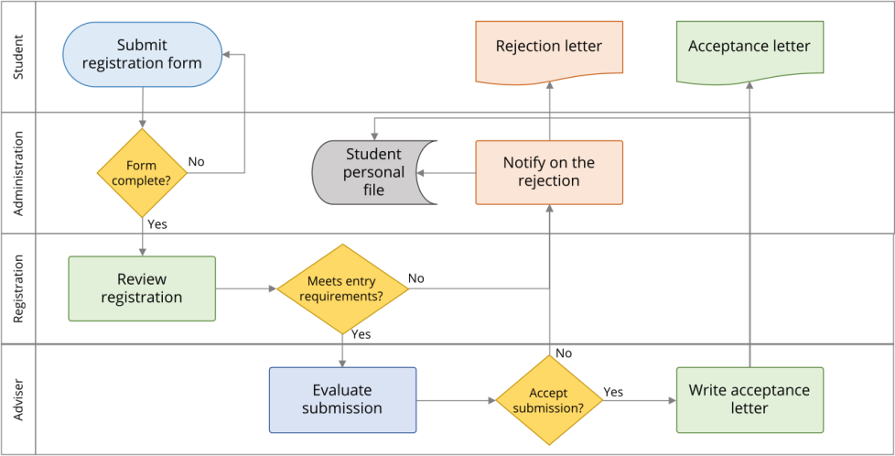
Documenting Scenario: Swimlane Diagram
See Software Requirements: 05.1. The Unified Modeling Language.pptx for details.

Slide 21

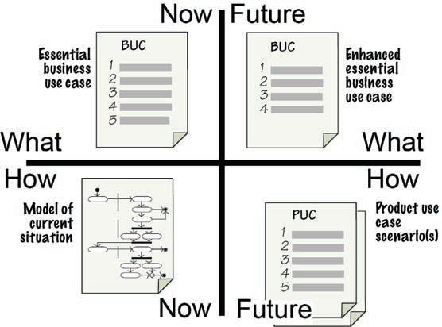
The Brown Cow Model (I) [1]
Creativity
Creativity

Slide 22
The Brown Cow Model (II)
People (all of us) see the world in terms of their own experience and importance, and their own levels of abstraction.
The requirements analyst needs to be able to unscramble these disparate viewpoints and decide what to focus on to further the goals of the project.
How Now Brown Cow is an elocution exercise designed to teach how to pronounce rounded vowel sounds.
The Brown Cow model provides a tool for taking four important systems viewpoints in parallel. It provides basis for requirements discovery.
The non-procedural nature of the model means that the analyst can choose to take the most relevant viewpoints in whatever order suits the particular situation.

Slide 23
Further Reading
Tom DeMarco (1979). Structured Analysis and System Specification.
Data-flow diagram.
Stephen M. McMenamin and John F. Palmer (1984). Essential Systems Analysis.
Event-partitioning approach.
Edward Yourdon (1989). Modern Structured Analysis. Prentice Hall.
Notes:
https://docs.google.com/file/d/0B42Cu1mD9Z7seVVHLUdqb1Q1SlU

Slide 24

Thank You & See You Again

